Slide 1



Network Layer
Module 3
Introduction

Slide 2
Network layer Services:
Packetizing
Routing and Forwarding
Provide Services to upper layers.
Other Features:
Error Control, Flow Control, Congestion Control, QoS and Security
Characteristics of IP:
Connectionless
Best Effort

Slide 3
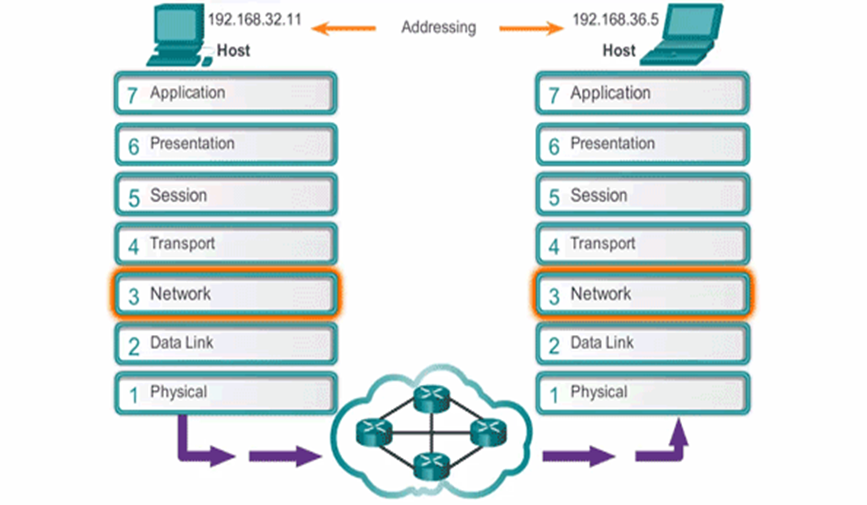
Communication at Network Layer

Slide 4
Address Space
IPv4 Address
IPv4 is 32 bit long
IPv4 is 32 bit long
Total Addresses available are
2³² i.e. 42,94,96,296
Note: If a protocol uses N bits to define an address, the address space is 2^{N} because each bit can have two different values (0 and 1) and N bits can have 2^{N} values.

Slide 5
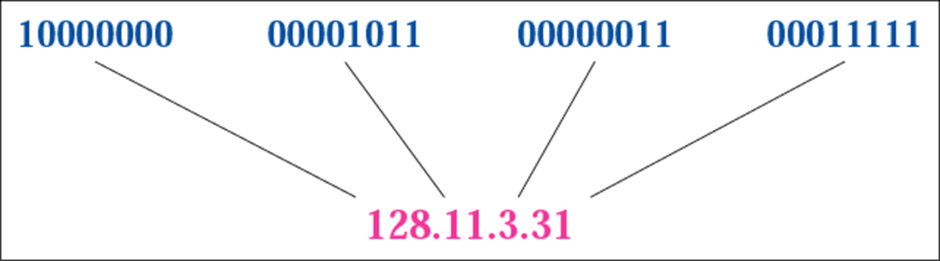
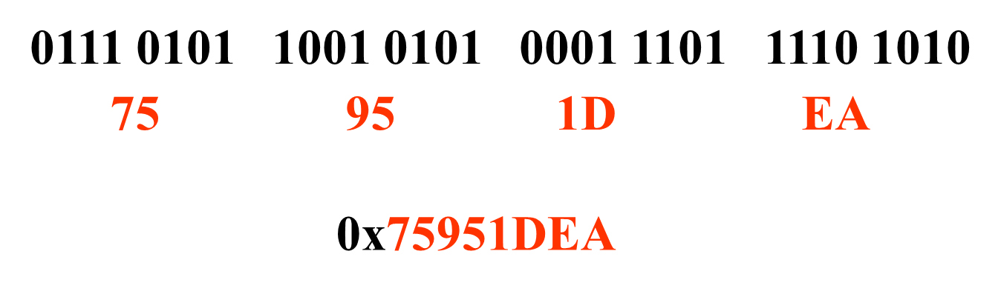
Dotted-Decimal Notation
Hexadecimal Notation

Slide 6
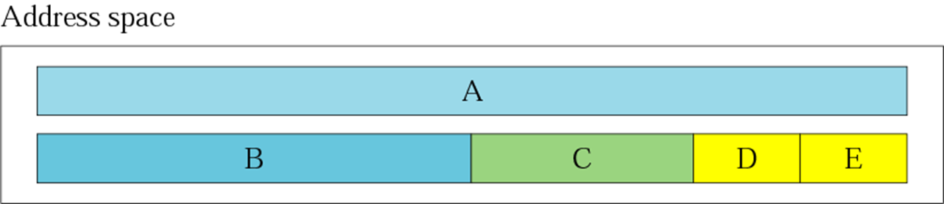
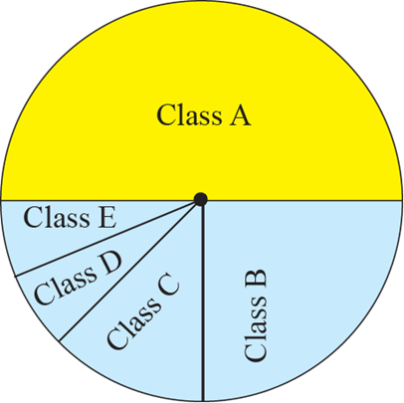
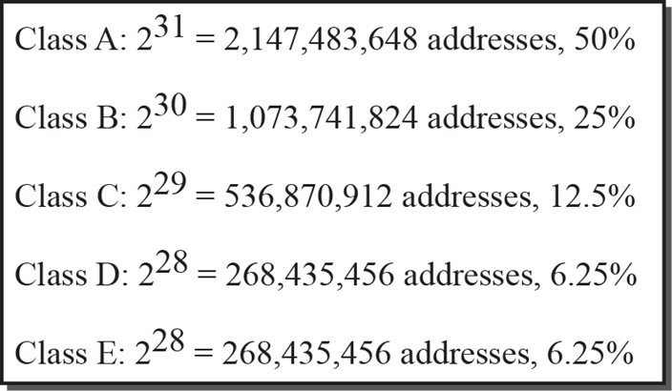
Classful Addressing
In classful addressing, the address space is divided into five classes: A, B, C, D, and E.

Slide 7
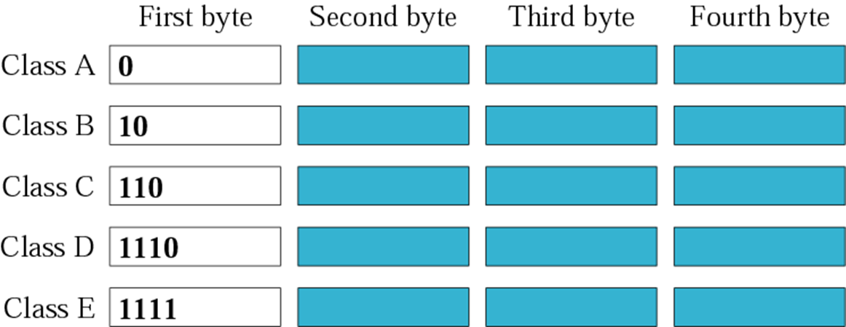
Finding the class in binary notation

Slide 8
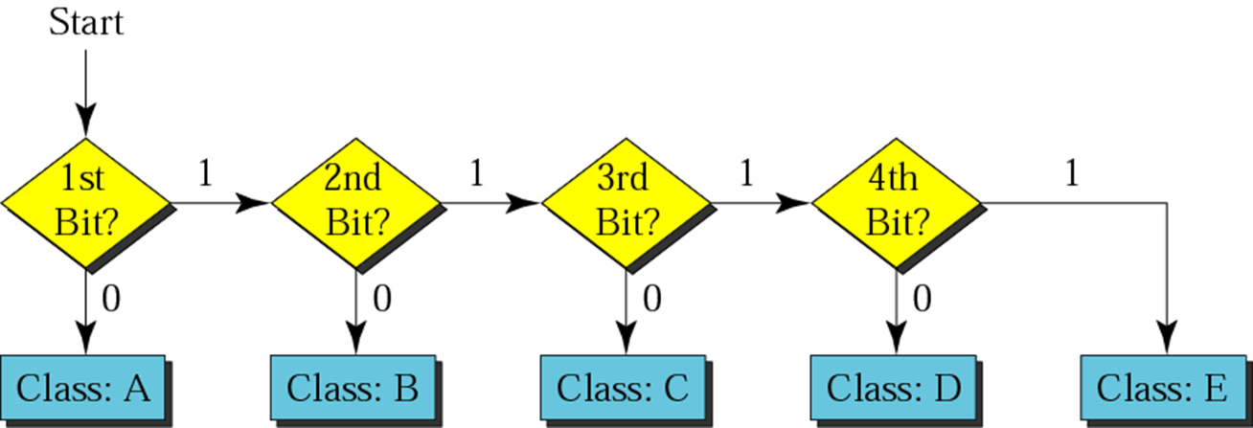
Finding the address class

Slide 9
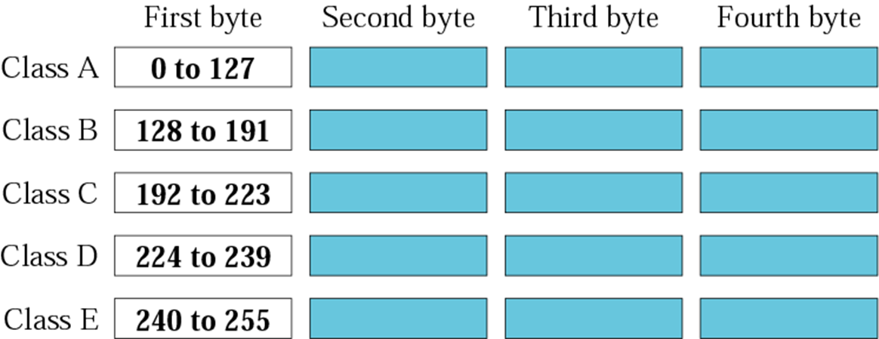
Finding the class in decimal notation
Note:
The range of addresses allocated to an organization in classful addressing was a block of addresses in Class A, B, or C.

Slide 10
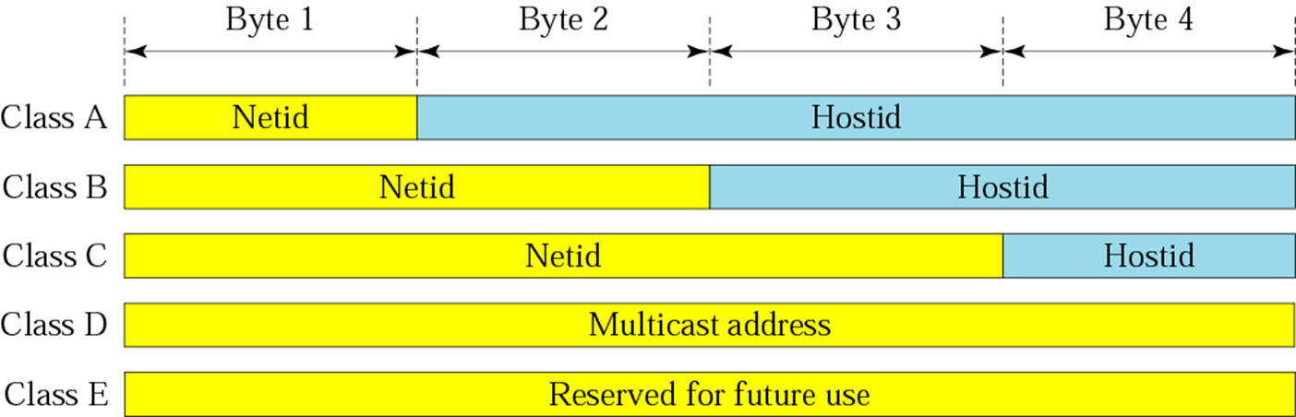
Net-ID and Host-ID

Slide 11
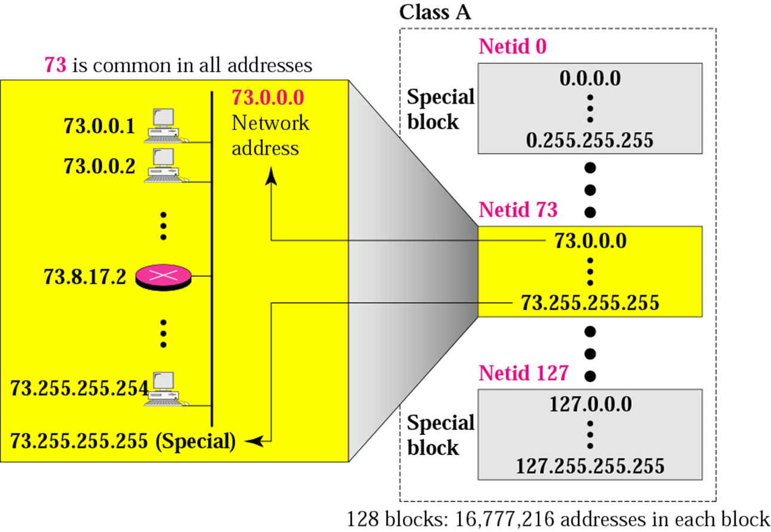
Blocks in class A
Note: Millions of class A addresses are wasted

Slide 12
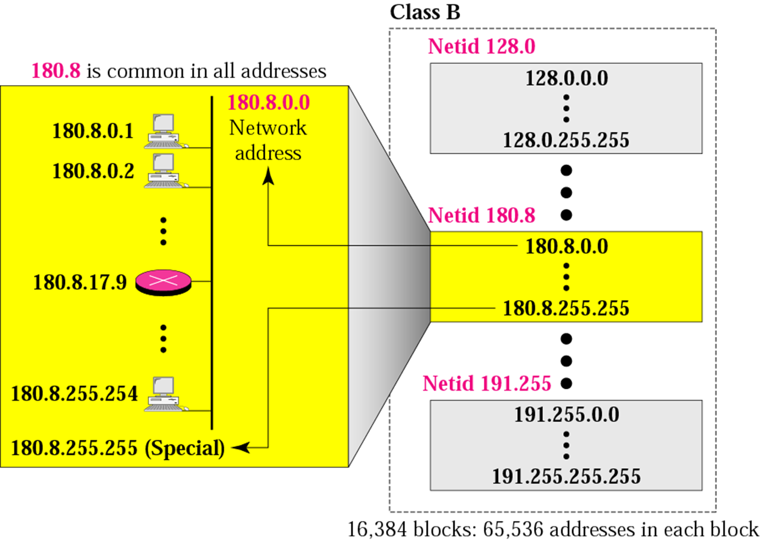
Blocks in class B
Note: Many class B addresses are wasted.

Slide 13
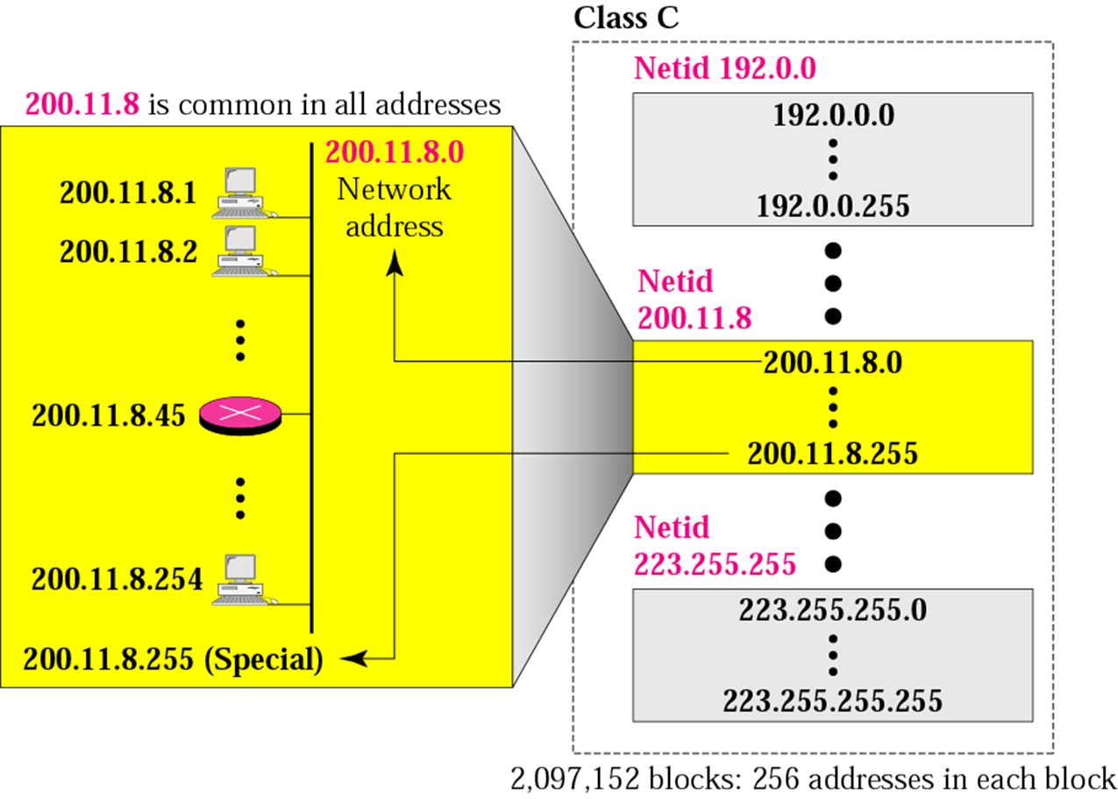
Blocks in class C
Note: The number of addresses in a class C block is smaller than the needs of most organizations.

Slide 14
Blocks in class D and E
Class D addresses are used for multicasting; there is only one block in this class.
In classful addressing, the network address (the first address in the block) is the one that is assigned to the organization.

Slide 15
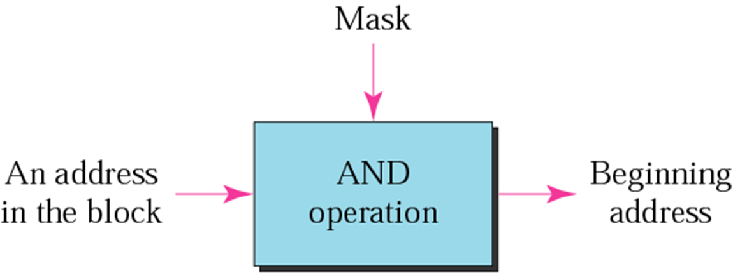
Mask
A mask is a 32-bit binary number that gives the first address in the block (the network address) when bitwise ANDed with an address in the block.

Slide 16
Mask
The network address is the beginning address of each block.
It can be found by applying the default mask to any of the addresses in the block (including itself).
It retains the net-id of the block and sets the host-id to zero.

Slide 17
Example
An address in a block is given as 73.22.17.25. Find the number of addresses in the block, the first address, and the last address.
Solution:
Figure shows a possible configuration of the network that uses this block.
The number of addresses in this block is N = 2^{32−n} =16,777,216.
To find the first address, we keep the leftmost 8 bits and set the rightmost 24 bits all to 0s. The first address is 73.0.0.0/8, in which 8 is the value of n.
To find the last address, we keep the leftmost 8 bits and set the rightmost 24 bits all to 1s. The last address is 73.255.255.255.

Slide 18
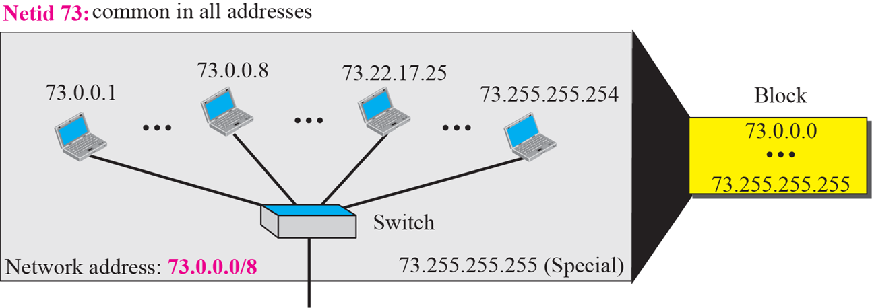
Example
Solution:
The number of addresses in this block is N = 2^{32−n} = 16,777,216.
To find the first address, we keep the leftmost 8 bits and set the rightmost 24 bits all to 0s. The first address is 73.0.0.0/8, in which 8 is the value of n.
To find the last address, we keep the leftmost 8 bits and set the rightmost 24 bits all to 1s. The last address is 73.255.255.255.

Slide 19
Note:
We must not apply the default mask of one class to an address belonging to another class.

Slide 20
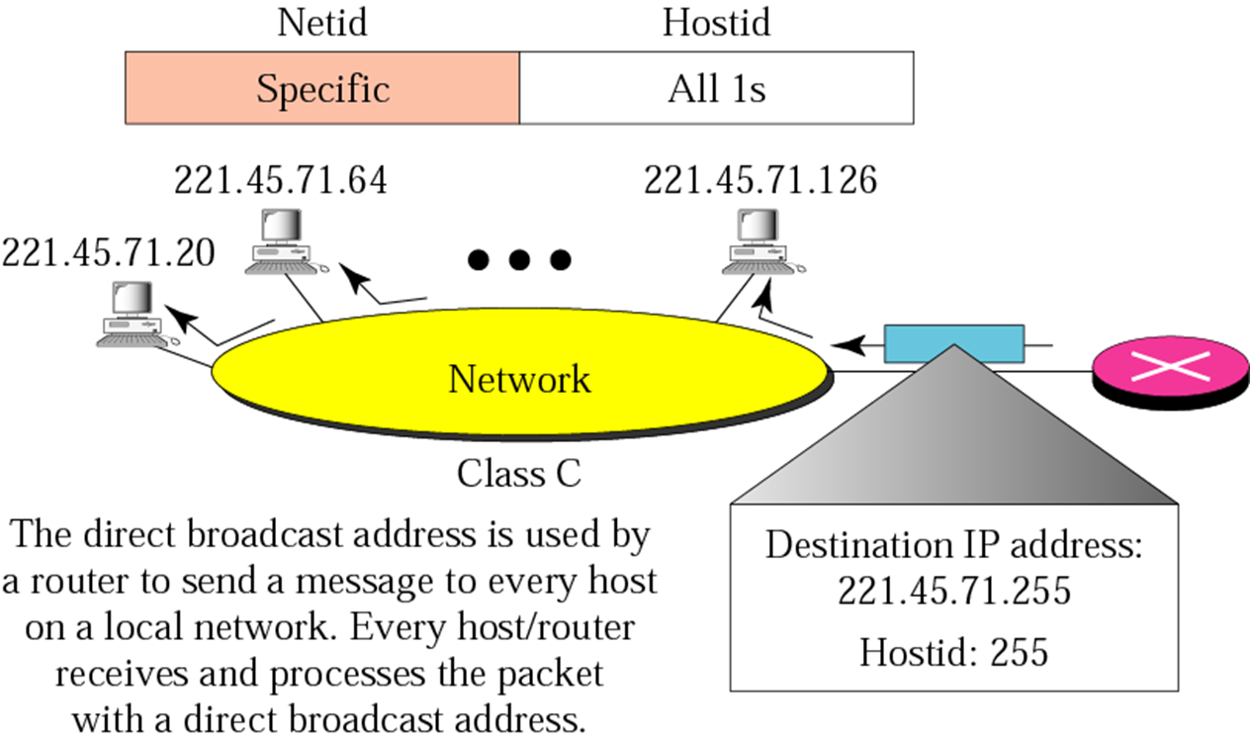
Example of direct broadcast address

Slide 21
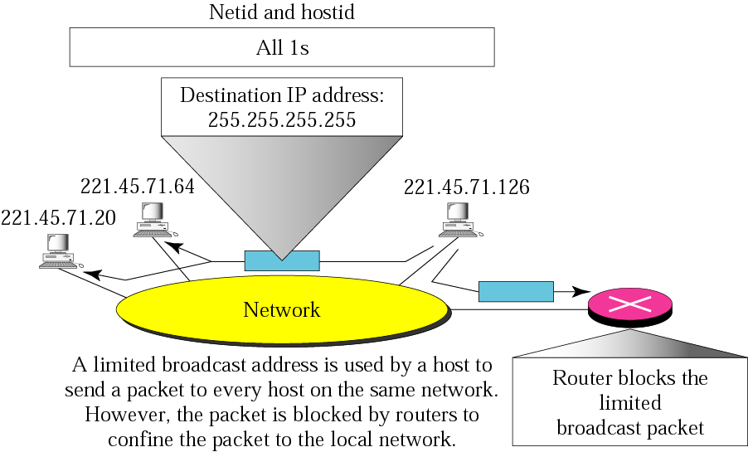
Example of limited broadcast address

Slide 22
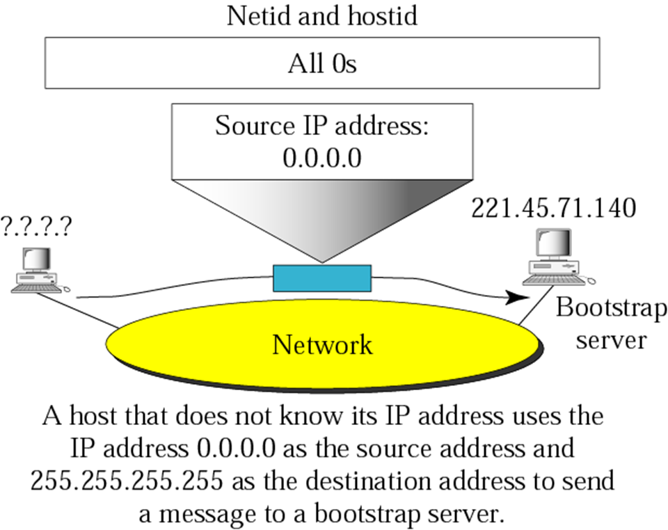
Example of “this” host on “this” address

Slide 23
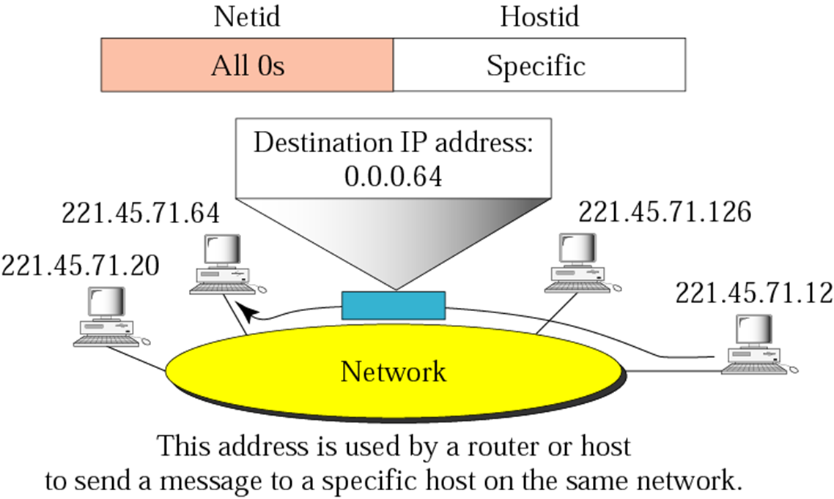
Example of specific host on “this” network

Slide 24
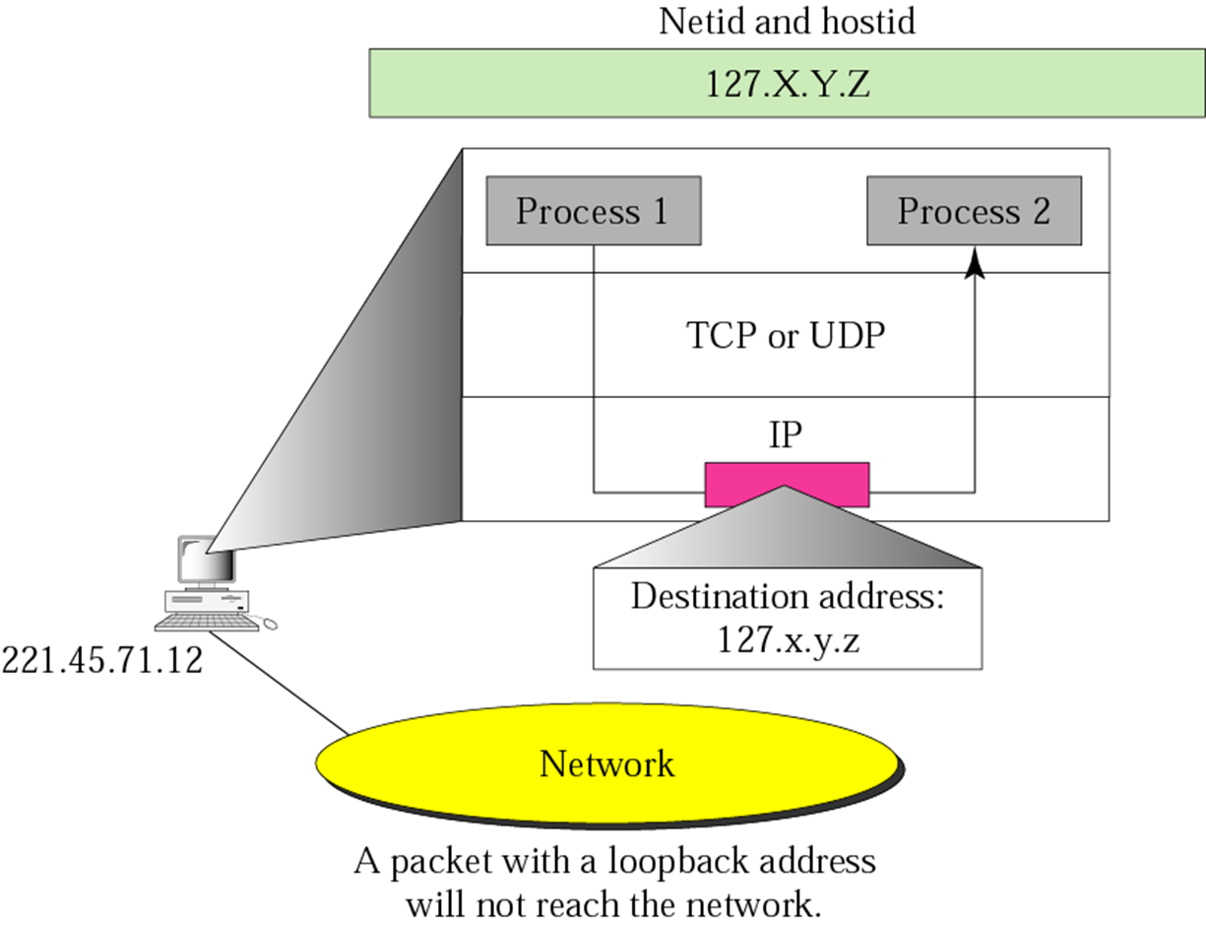
Example of loopback address

Slide 25
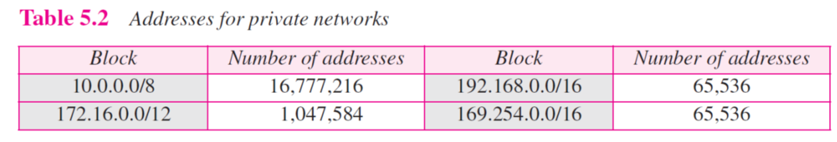
Private Addresses
A number of blocks in each class are assigned for private use. They are not recognized globally.

Slide 26
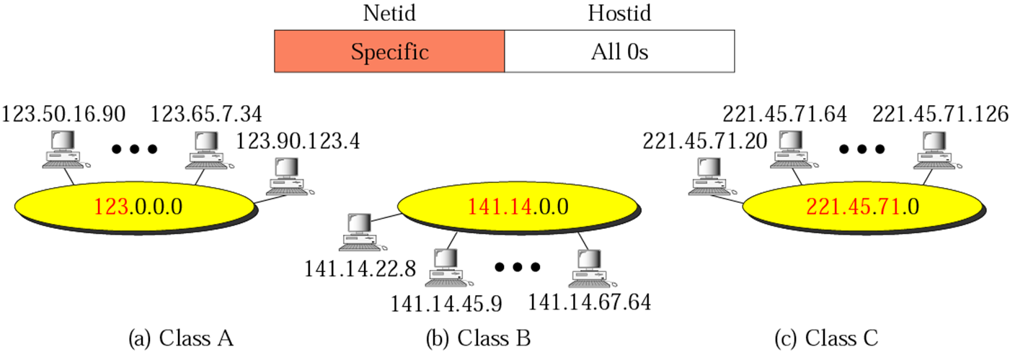
Network addresses

Slide 27
Network addresses
The network address is the first address.
The network address defines the network to the rest of the Internet.
Given the network address, we can find the class of the address, the block, and the range of the addresses in the block

Slide 28
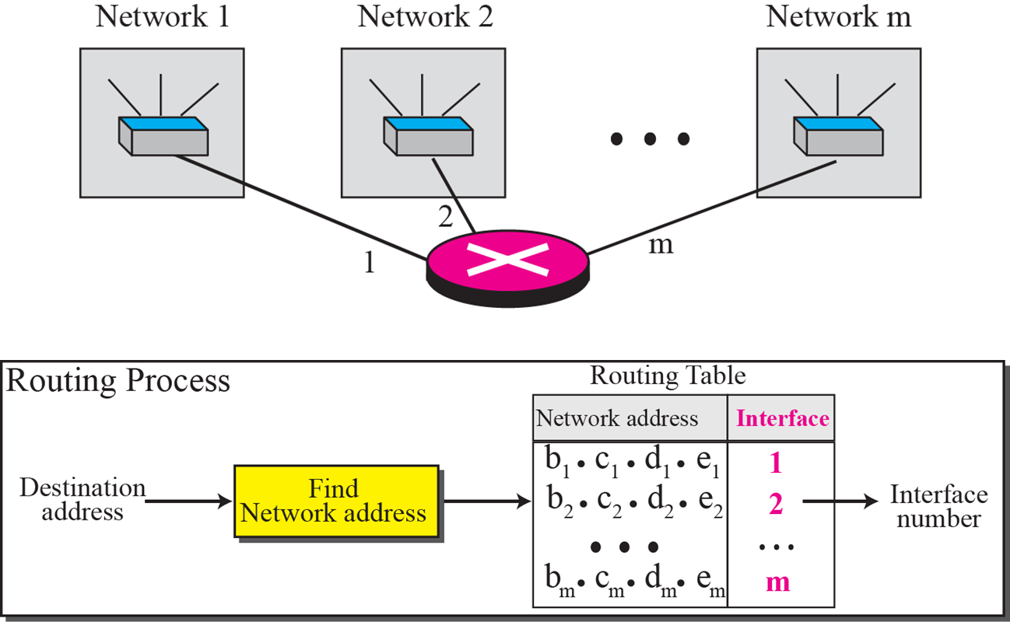
Network addresses

Slide 29
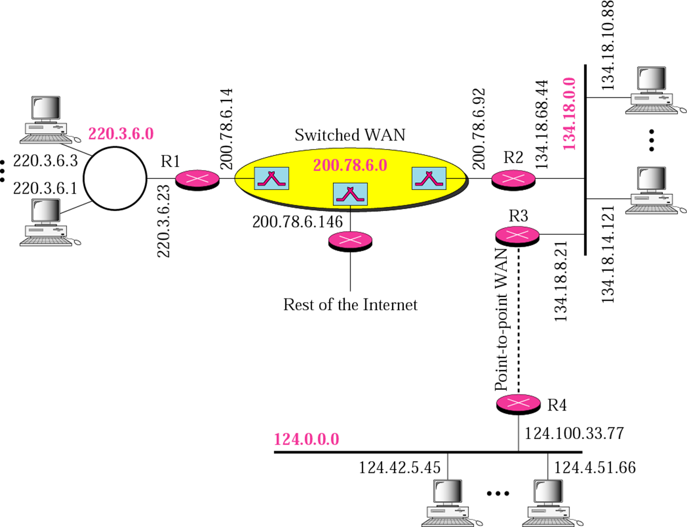
Sample internet

